Slide 1
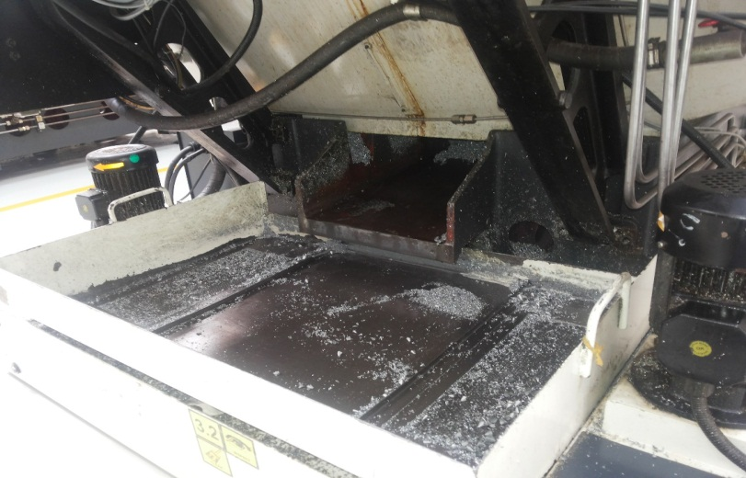
P15
TPM CIRCLE NO :- 01
ACTIVITY
KK
QM
PM
JH
SHE
OT
DM
E&T
KAIZEN IDEA SHEET
TPM CIRCLE NAME: Achiever
LOSS NO. / STEP
DEPT :- MACHINE SHOP
RESULT AREA
P
Q
A
B
C
D
S
M
CELL:- A105 FL WT
CELL NAME:- oil pump
MACHINE / STAGE :-
OPERATION :- DRILLING
KAIZEN THEME:- To reduce excess burr going in coolant tank
IDEA :-To locate small hole size net on coolant tank
PROBLEM PRESENT STATUS :excess burr going in coolant tank so coolant reduces pressure of coolant in tank so provided small size net increase coolant level
COUNTERMEASURE:-
1 excess burr going in coolant tank so that coolant level decreases and locate small size net
BENCHMARK
MINOR
TARGET
0
KAIZEN START
15.08.2016
TDC
26.08.2016
KAIZEN FINISH
26.08.2016
TEAM MEMBERS :KESHOR PAWAR,
MARUTI PATIL
BENEFITS :-
Increases to quality
Before
After
KAIZEN SUSTENANCE
WHY - WHY ANALYSIS :-
Why1 :- coolant tank net hole size is big
Why2 :- coolant tank net break condition
Why3 :- excess burr going in coolant tank
Why4 :- coolant level decreases
RESULT : increases coolant level, avoid
dent mark and break drill
WHAT TO DO:
HOW TO DO:-
FREQUENCY :- Daily.
SCOPE & PLAN FOR HORIZONTAL DEPLOYMENT
Sr No | CELL | TDC | RESP. | STATUS
1
2
ROOT CAUSE : coolant level less at machine in run condition
REGISTRATION NO. & DATE : 15.08.2016
REGISTERED BY :- Umesh pimple
MANAGER’S SIGN :- D . pawar
1
1

